Slide 1
Unit 1: The Evolution of Psychology
History and Perspectives
AP Psychology
Nick Gaunt

Slide 2
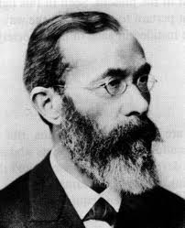
“The Man”
        Wilhelm Wundt
        1879
        University of Leipzig
        Independent Discipline
        Believed the focus of psychology should be examining people’s awareness of their immediate experience.
        International Influence:
        G. Stanley Hall 1883 @Johns Hopkins
        by 1893 24 new laboratories in US

Slide 3
Psychology in the U.S.
Two first schools of thought:
Structuralism vs. Functionalism
Founder: Edward Titchener Founder: William James
Theory: Analyze consciousness Theory: Investigate the functions
Into basic elements of consciousness
Key Idea: Introspection- Led to investigations in:
The careful, systematic mental testing, developmental
Observations of one’s own patterns, and sex differences
Consciousness. Strongly influenced by Darwin

Slide 4
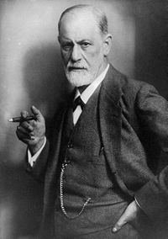
Influential Psychologists
1. Sigmund Freud
Austrian
Founder: Psychoanalytic Theory
Emphasis on the Unconscious
Outside awareness
That influences behavior Behavior influenced People resisted
by how people deal with Uncomfortable sexual urges

Slide 5
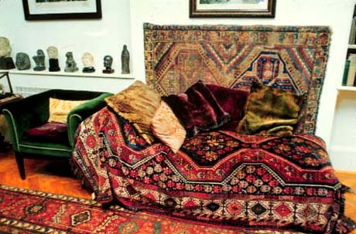
Freud’s Ideas:
Controversy and Influence
Behavior is shaped by the Unconscious
Unconscious conflict related to sexuality plays a central role in shaping behavior
Example: Freudian slips
Controversial- are we in control of ourselves?
Sex=Taboo
Lasting influence on the
field of psychology

Slide 6

Influential Psychologists
2. John B. Watson
United States
1913-1920s
Founder: Behaviorism
Behavior- any overt/observable response or activity by an organism
Redefines scientific psychology – VERIFIABLE
Looks at Stimulus Response
in animal research (Pavlov’s Dog)
Nature
Vs.
Nurture

Slide 7
Nature vs. Nurture:
Are people born or made?
“Give me a dozen healthy infants, well-formed, and my own specified world to bring them up in and I’ll guarantee to take any one at random and train him to become any type of specialist I might select—doctor, lawyer, artist, merchant-chief and, yes, even beggar-man and thief, regardless of his talents, penchants, tendencies, abilities, vocations, and race of his ancestors.”
-John B. Watson(1930)

Slide 8
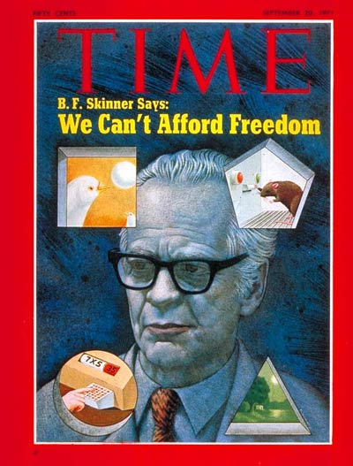
Influential Psychologists
3. B. F. Skinner
1950s
Behaviorist
Positive outcomes
Free will is an ILLUSION

Slide 9
Other Key Theories/Perspectives in Psychology
Humanism
1950s – Rejection of Behaviorism and Skinner
Emphasis on the unique qualities of humans
Critics – Optimistic viewpoint
Thinkers: Carl Rogers and Abraham Maslow

Slide 10
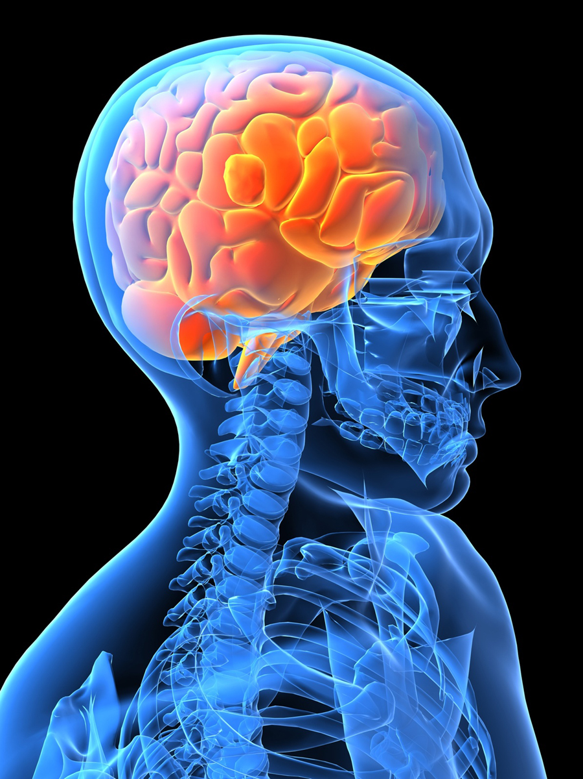
1950s & 1960s
Cognition’s Comeback
The big C:
Mental process involved in acquiring decision making. knowledge
Research highlights Interrelation of
mind, body, and behavior
New Dominant Perspective?
1970 surpassed Behaviorism

Slide 11

Neurobiological Theory
Biological Perspective-
Behavior explained in terms of physiological processes
Examples: James Olds (1956)
Electrical stimulation of the
brain evokes emotional
responses in animals
Roger Sperry (1981)
Left and right brain hemisphere specialization

Slide 12

Evolutionary Theory

Slide 13
Behavioral tendencies = the result of natural selection
Key Thinker: David Buss – studies on mating preferences

Slide 14
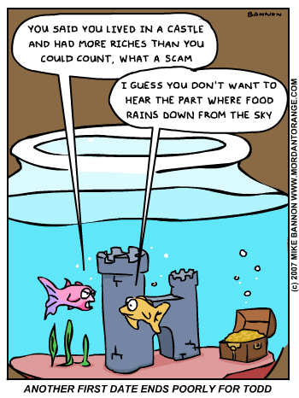

Slide 15

Conclusion
Psychology has evolved over the last 125 years from a philosophical speculation to a scientifically sound research/ field of study with diverse perspectives
Today there are 7 major areas of research in psychology: These will be the basis for our course.
7 MAJOR AREAS OF PSYCHOLOGICAL RESEARCH
*Developmental Psych *Physiological Psych *Psychometrics
*Social Psych *Cognitive
*Experimental Psych *Personality

