Slide 1
Scientific Methods
Ch. 2
AP Psychology

Slide 2
“I know there is no evidence that shows the death penalty has a deterrent effect…but I just feel in my gut it must be true.”
- then Texas Gov. George W. Bush
152 prisoners executed,
More death executions signed than any other Texas Gov. averaging a death every 9 days.

Slide 3
“Psychology is the science of the intellects, characters and behavior of animals including man.” – Edward Thorndike
SCIENTIFIC APPROACH
Assumes that events are governed by some lawful order
Measurement and Description
develop measurement techniques to clearly describe behavior
3 main goals of Psychologists

Slide 4
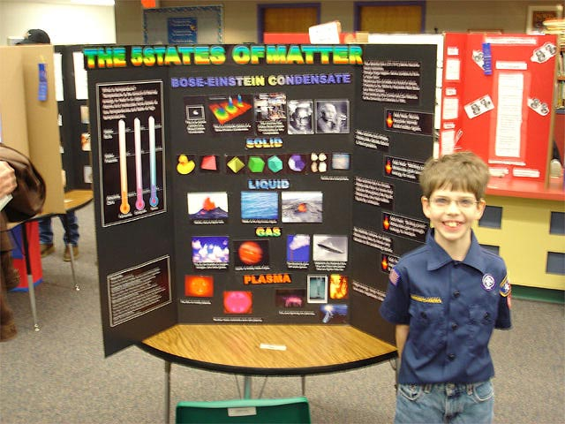
Psychologists’ goals continued…
2. Understanding and Prediction
In order to understand- need to be able to explain
reasons behind the behavior.
Before you can check for understanding need to make a prediction
Hypothesis
Variables
3. Application and Control
Isn’t this the whole idea of psychology?!

Slide 5
“If the facts don’t fit the theory, change the facts.” – Albert Einstein
Theory – linking ideas to explain a set of observations
Looking to find a relation and link together as part of a whole
Example: Self Esteem and Depression?
What happens if the findings support/do not support the hypothesis?

Slide 6
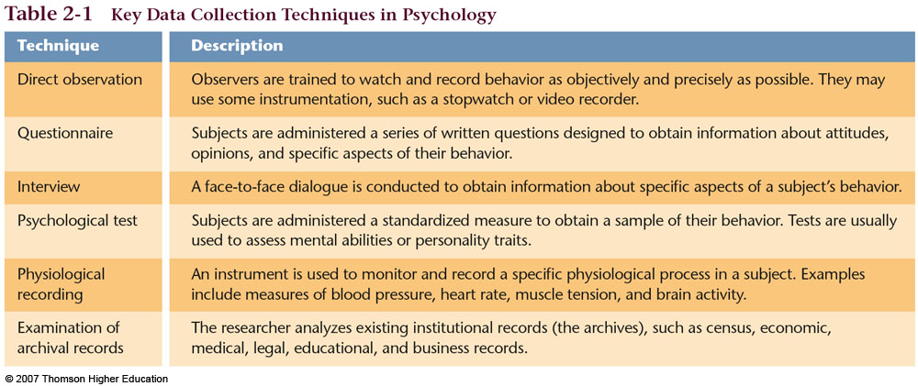
Steps in a Scientific Investigation
Step 1: Formulate a testable hypothesis
Need a clearly defined Operational Definition- what each variable means in the context of the study.
Step 2: Select the research method and design the study
Types of research methods?
Participants/Subjects- people/animals observing
Step 3: Collect the data
.

Slide 7
Step 4: Analyze the data and draw conclusions
observations #s = Raw Data
Use Statistics – analyze data, hypothesis supported?
Step 5: Report the findings
Scientific Journal
Peer Review and the unlucky
90%

Slide 8
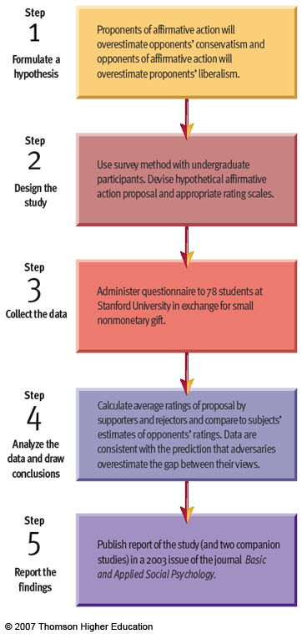

Slide 9
Research Methods
How should we conduct a scientific study?
Experimental Research
Purpose of the experiment=
Whether changes in one
Variable causes changes in
The other variable
Cause-and-Effect Relationships
Philip Zimbardo’s Stanford Prison Experiment

Slide 10
Variables
Independent Variable (IV) = Variable manipulated
Dependent Variable (DV) = Variable affected by manipulation
Question to ask in an experiment: “How does X affect Y?”
X=IV
Y=DV
Extraneous and confounding variables

Slide 11
Participants=Groups
In Experiments: usually 2 groups of participants/subjects who are treated differently in regards to the independent variable.
Experimental Group & Control Group
Subjects receive some similar group of subjects
Kind of special treatment who do NOT receive
In regard to the independent the special treatment
Variable given to the
experimental group

Slide 12
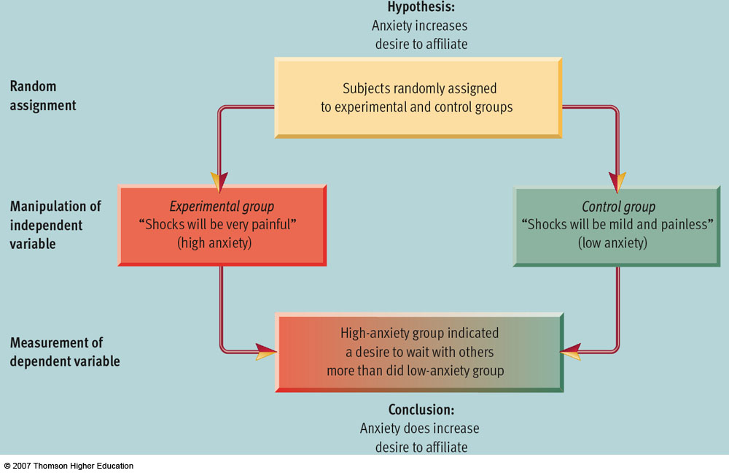

Slide 13
Advantages/Disadvantages to Experimental Research
Remember the goal: to isolate the relationship between the independent and dependent variable while neutralizing the effect of extraneous variables.
Again looking for a cause and effect relationship
Advantage: Strongest research method. Preferred by psychs&Scient.s
Disadvantage: Artificial.
Ethical concerns

Slide 14
Philip Zimbardo’s Stanford Prison Experiment 1971
Investigate the highly controversial experiment
What is Z.’s hypothesis?
Experimental/Control Groups – Random Assignment?
Variables
Analyze and report the results

